Slide 1

Project Review - 3
Course Code - 24DEA3101
Faculty : Dr. N. Shirisha
Associate Professor
Real-Time Banking Transaction Analytics & Anomaly Monitoring Platform
FDE TEAM 21
B Raghu Nandan - 2420030058
C Pravin Sai - 2420030777
J Hemanth - 2420039805

Slide 2
METHODOLOGY
01 DATA GENERATION
Generate synthetic banking transactions using Python.
02 DATA INGESTION
Publish transactions continuously to Apache Kafka.
03 DATA PROCESSING
Use PySpark Structured Streaming for validation and transformation.
04 DATA STORAGE
Store valid data in Bronze/Silver Delta layers and invalid data in Quarantine.
05 ANALYTICS
Calculate anomaly indicators and prepare business-ready data.
06 OUTPUT
Use Airflow for Gold processing, SQLite for storage and Power BI for visualization.

Slide 3
SYSTEM DESIGN
INPUT LAYER
Python → Kafka
Synthetic transaction events
PROCESSING LAYER
PySpark Structured Streaming
Schema + validation + transformation
STORAGE LAYER
Bronze / Silver Delta Lake
Quarantine for invalid records
ORCHESTRATION LAYER
Apache Airflow
Silver-to-Gold workflow
PRESENTATION LAYER
SQLite Gold Star Schema
Power BI dashboards

Slide 4
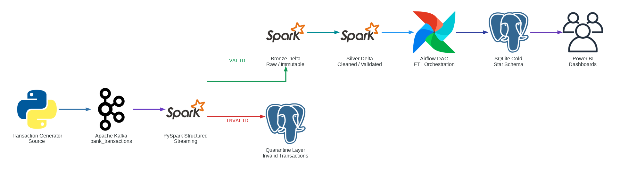
System Architecture

Slide 5
USE OF MODERN TOOLS AND TECHNOLOGIES
PYTHON
Synthetic transaction generation
APACHE KAFKA
Real-time event streaming and buffering
PYSPARK
Structured streaming, validation and transformation
DELTA LAKE
Reliable Bronze and Silver storage
AIRFLOW
Workflow orchestration and task management
SQLITE + POWER BI
Gold analytics storage and business visualization

Slide 6
THANK YOU

